Slide 1
DepEd Order No. 36, s. 2016
Policy Guidelines on Awards and Recognition for the K to 12 Basic Education Program

Slide 2
“Awards and recognition programs
create a positive learning environment,
improve pupil/student morale and
motivate high performance.”

Slide 3
“RATIONALE.”

Slide 4
This policy aims to give all learners equal opportunity to excel in relation to the standard set by the curriculum and focus on their own performance rather than to compete with one another.

Slide 5
It recognizes that all students have their unique strengths that need to be identified, strengthened, and publicly acknowledged.

Slide 6
The awards aim to acknowledge and promote student excellence and to provide formal recognition of student achievements that can motivate learners to strive for excellence in academic, leadership, and social responsibility.

Slide 7
Learners who feel good about their abilities and contributions to the school and society are more likely to be happy, content, and motivated. When these learners are recognized for their efforts, they will also persist in their desire to excel.

Slide 8
The giving of awards and recognition is but one of the many ways by which teachers and schools provide students with positive feedback and affirmation, which can improve the learner’s confidence, self- awareness, and enthusiasm for learning.

Slide 9
A motivating environment that promotes respect for student diversity and dedication to learning contributes to the creation of a positive school climate that supports the well-being and achievement of all students.

Slide 10
“AWARDS.”

Slide 11
CLASSROOM AWARDS
are recognition given to learners in each class or section. A simple recognition may be given per quarter, semester, or at the end of the school year.

Slide 12
Awardees are given merit by the adviser and/or other subject teachers in
recognition of the learners’ outstanding performance in class.

Slide 13
CLASSROOM AWARDS
Performance Awards for Kindergarten
2.Conduct Awards
2.1. Character Traits for Kindergarten to Grade
3 2.2. Conduct Awards for Grades 4 to 12
3. Academic Excellence Awards
CLASSROOM AWARDS
4. Recognition for Perfect Attendance

Slide 14
Performance Awards for Kindergarten Learners

Slide 15
Performance Awards for Kindergarten Learners should be recognized for their most evident and most prominent abilities.
Teachers will recognize outstanding achievement of learners based on the different domains and/or learning competencies of the kindergarten curriculum at the end of every quarter.

Slide 16
SUBJECT
AWARD
Communication Arts/ Self- Expression
Literacy (Reading and Writing)
Numeracy (Mathematical Skills)
Science Performing Arts
(Dancing and Singing)
Physical Agility
Self-Care
Visual Arts (Coloring/Drawing)
Spectacular Speaker Award
The Star Reader Award
Writing Wizard Award
MATHinik Award
The Little Scientist Award The Little Star Award The Athletic Kid Award
The Neat Kid Award
The Awesome Artist Award

Slide 17
Conduct Awards

Slide 18
2. Conduct Awards
These are given to learners who have been observed to consistently demonstrate the DepEd core values (Maka-Diyos, Makatao, Makakalikasan, Makabansa) as translated in our Report Card.

Slide 19
2.1. Character Traits for Kindergarten to Grade 3
These awards are given to younger learners to affirm their positive traits and attitudes or to recognize significant improvement in their behavior.

Slide 20
CHARACTER TRAITS FOR KINDERGARTEN TO GRADE 3
AWARDS
1. Active (participation)
Spunky Spirit Award
2. Cheerfulness
Sunshine Award
3. Cooperation/Team player
Team Player Award
4. Friendliness
Friendly Neighbor Award
5. Gentleness
Peace Keeper Award
6. Hardworking
Busy Bee Award
7. Helpfulness
Cheerful Helper Award
8. Honesty
Matapat Award
9. Initiative
Sparkler Award
10. Kindness
Golden Heart Award
11. Leadership
True Leader Award
12. Motivation / Enthusiasm
Eager Beaver Award

Slide 21
CHARACTER TRAITS FOR KINDERGARTEN TO GRADE 3 | AWARDS
13. Patience | Patience Advocate Award
14. Perseverance | Extra Miler Award
15. Persistence | Tenacious Striver Award
16. Politeness/Courtesy | Courteous Kid Award
17. Responsibility | Batang Maasahan Award
18. Risk taking | Brave Soul Award
19. Self-discipline | Prudent Worker Award
20. Sharing | Great Giver Award
21. Sportsmanship | Good Sport Award

Slide 22
2.2. Conduct Awards for Grades 4 to 12
Conduct Awards for grades 4 to 12 in each class will be given at the end of the school year. This will be based on the evaluation of the adviser and subject teachers.

Slide 23
CHARACTER TRAITS FOR GRADES 4 TO 10 AWARDS
Most Active Award Most Respectful Award Most Attentive Award Most Diligent Award
Most Brave Award Most Trustworthy Award Most Behaved Award Most Responsible Award Most Cheerful Award Most Flexible Award Most Creative Award Most Determined Award
Most Caring Award Amazing Attitude Award Most Compassionate Award Promptness Award
Most Encouraging Person Award Environment-Friendly Award True Leader Award Most Cooperative Award
Most Enthusiastic Award Brave Heart Award
Most Diligent Award Most Hard Working Award

Slide 24
Academic Excellence Award

Slide 25
3. Academic Excellence Award
Award for Academic Excellence within the quarter is given to learners from Grades 1 to 12 who have attained an average of at least 90 and passed all learning areas.
The Average Grade per Quarter is reported as a whole number
following DepEd Order No. 8, s.
2015.

Slide 26
Academic Excellence Award
General
Average
With Highest Honors
98-100
With High Honors
95-97
With Honors
90-94

Slide 27
Recognition for Perfect Attendance

Slide 28
4. Recognition for Perfect Attendance
This award is given at the end of every quarter to encourage learners to attend and actively participate in class. Perfect attendance means that a learner must be present in all of his/her classes, and must have no absences for the entire quarter.
Learners who are representing the school for various purposes (e.g., in-school or off campus activities, practices, sports) may also qualify for this award.

Slide 29
GRADE LEVEL AWARDS

Slide 30
GRADE LEVEL AWARDS are given to qualified learners for every grade level at the end of the school year.
Candidates for the awards are deliberated by the Awards Committee (AC) if they have met the given criteria.

Slide 31
Academic Excellence Award
is given to learners from grades 1 to 12 who have attained a General Average of at least 90 and a passing Final Grade in all learning areas.
The General Average is reported as a whole number following DepED Order No. 8, s. 2015.

Slide 32
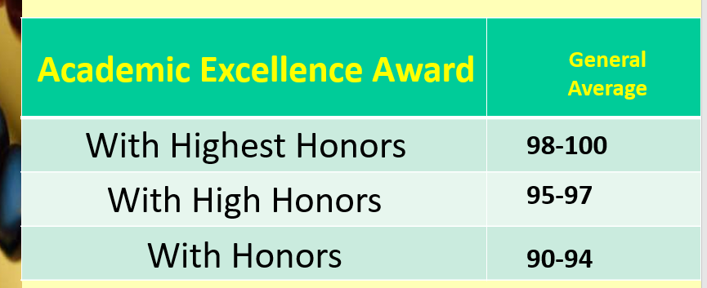

Slide 33
Leadership Award
1. The leadership award is given to learners in Grades 6, 10, and 12 who have demonstrated exemplary skills in motivating others and organizing projects that have significantly contributed to the betterment of the school and/or community. This award is given during the completion or graduation ceremony.

Slide 34
Leadership Award

Slide 35
Award for Outstanding Performance in Specific Disciplines
Award
These awards are given to recognize learners in grades 6, 10, and 12 who have exhibited exemplary skills and achievement in specific disciplines. These disciplines are Athletics, Arts, Communication Arts, Mathematics and Science, Social Sciences, and Technical-Vocational Education (Tech- Voc).

Slide 36
Award for Outstanding Performance in Specific Disciplines
Award
Athletics
Arts (e.g., visual, media, music, or
performing arts)
Communication Arts
Science
Mathematics
Social Sciences
Technical-Vocational Education

Slide 37
Award for Outstanding Performance in Specific Disciplines Award

Slide 38
Award for Work Immersion is specific to Senior High School (SHS) tracks. This award may be given to grade 12 graduating students who have exemplified outstanding performance based on the terms of reference or engagement set by the school and evaluation of the direct supervisor and subject teacher.

Slide 39
Award for Research or Innovation is specific to Senior High School (SHS) tracks. Grade 12 graduating students-individuals, pairs, or groups of not more than four members-must have led the planning and execution of a research or innovation to advance the potential applications of technology, or research whose findings can be used to drive better efficiency and productivity as well as to improve the lives of the people in the school and/or community.

Slide 40
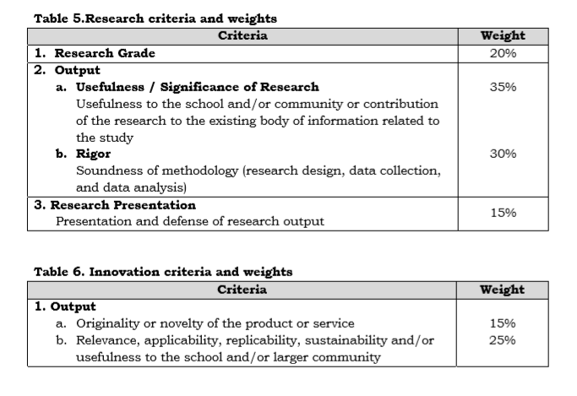
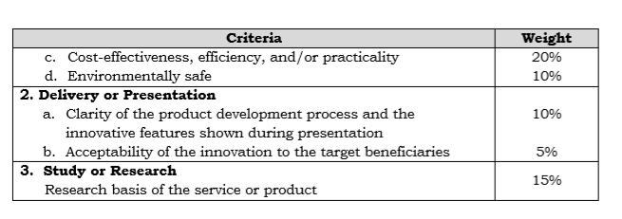

Slide 41
Award for Club or Organization Achievement is given to a duly recognized club or organization that has created positive impact on the school and/or community it serves through the implementation of all its planned projects and activities, provided strong support to the implementation of the school activities and attainment of the school’s objectives, and taken great strides to help its members develop their potentials.

Slide 42
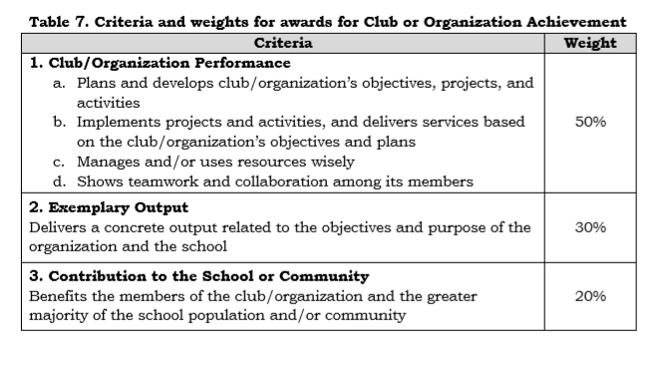

Slide 43
SPECIAL RECOGNITION is given by the school to the learners who have represented and/or won in competitions at the district, division, regional, national, or international levels.

Slide 44
What do awardees receive?

Slide 45
1. Classroom Awards
The pupils/students will receive certificates.
2. Grade Level Awards They will receive:
a. Medals
b. Certificates
c. Plaques

Slide 46
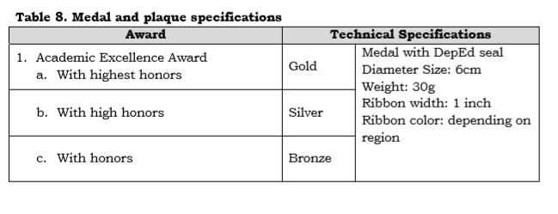
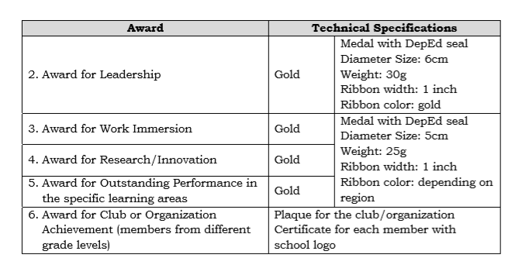

Slide 47
How do determine awardees?

Slide 48
An Awards Committee (AC) shall be organized by the Principal for each grade level.
The committee will be composed of the Directress, the Principal, the Coordinator, and the Class Adviser.

Slide 49
3. No member of the AC must be related within The second degree of consanguinity or affinity to any of the candidates for awards.
4. The report on the results of the AC shall be signed by all members of the committee and certified by the Principal.

Slide 50
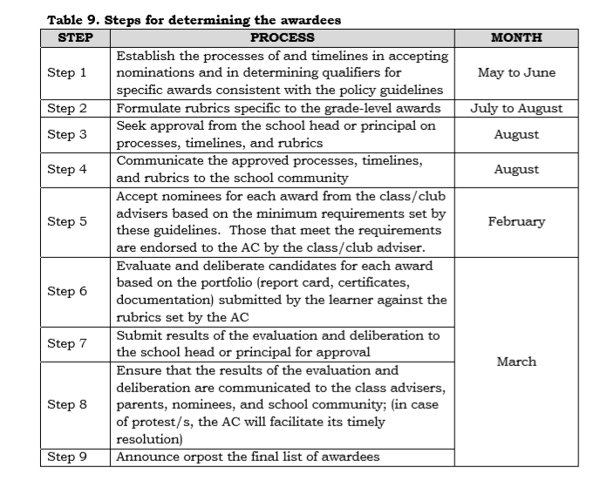

Slide 51
When to file and settle protests?

Slide 52
Cases of protest shall be filed by the candidate with his/her parent or guardian to the School Head within three (3) working days from the announcement and shall be decided on by the Principal, considering the recommendations of the AC within three (3) working days from filing.

